Slide 1

Data Analytics Project
by Dhruv Sikarwar
Analyzing Movie Trends of Ratings & Genres.
Insights of Budget & Box -Office Collection.

Slide 2
AGENDA
Problem
Goal
Data
Insights
Recommendations

Slide 3
PROBLEM STATEMENT
A Movie Production House wants to know which Genre and Director movies have made High Box-Office Collection.

Slide 4
GOALS
Goal 1: Data Cleaning & Standardization to ensure accurate analysis.
Goal 2: Develop data-driven recommendations for upcoming movie selection.
Main Question:-
Does higher rating leads to higher Box-Office Collection ?
Which Genre has collected highest profit ?
Which Director has produced more profitable movies ?
Is there a relationship between movie budget and box office collection ?

Slide 5
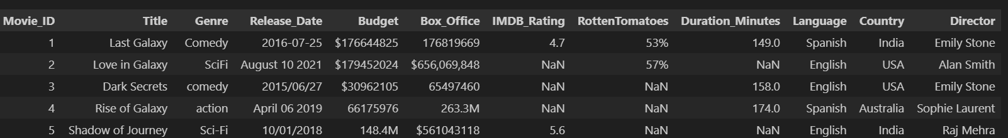
Data : Overview
Data : Movie Production House (2016 - 2020)
Source : Kaggle
Size : 5200 rows & 12 columns
Fields : Title,Genre,Release_Date,Budget,Box_Office,Language,Director ,etc.

Slide 6
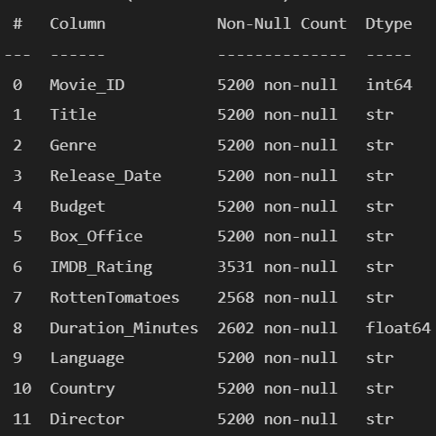
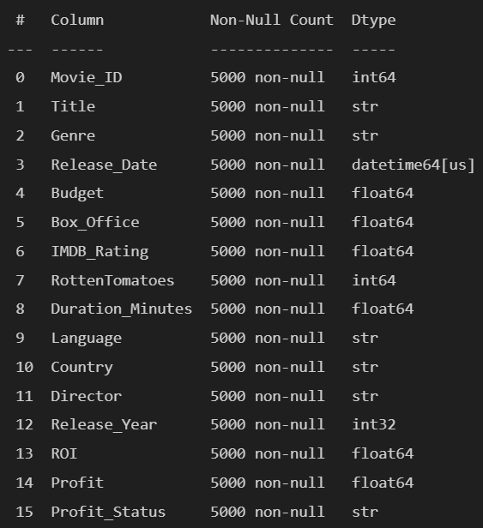
Data : Cleaning
Before
After

Slide 7
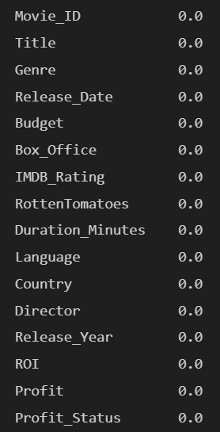
Data : Major Changes
Standardized the Box_office & Budget by replacing ($,M,comma).
Changed Data type of Date column to Date time format for time-based analysis .
Removed 200 duplicate rows.
Handled missing values by assigning group by average of respective column or another.
Added 4 new columns(Release_Year,ROI,Profit,Profit_Status).

Slide 8
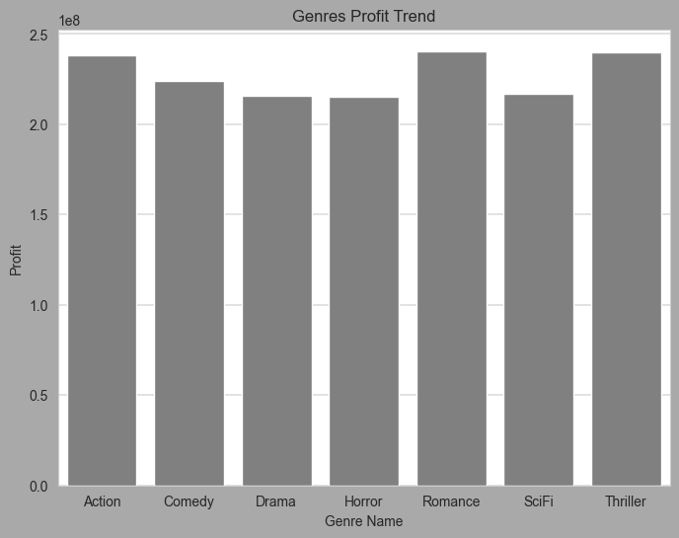
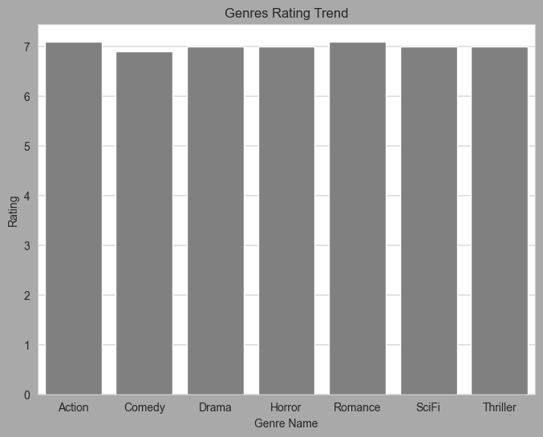
Insights: Genre Term
#Insight 1: Action,Thriller & Romance generates good profit while Drama in spite of being good in critics falls behind in generating revenue.

Slide 9
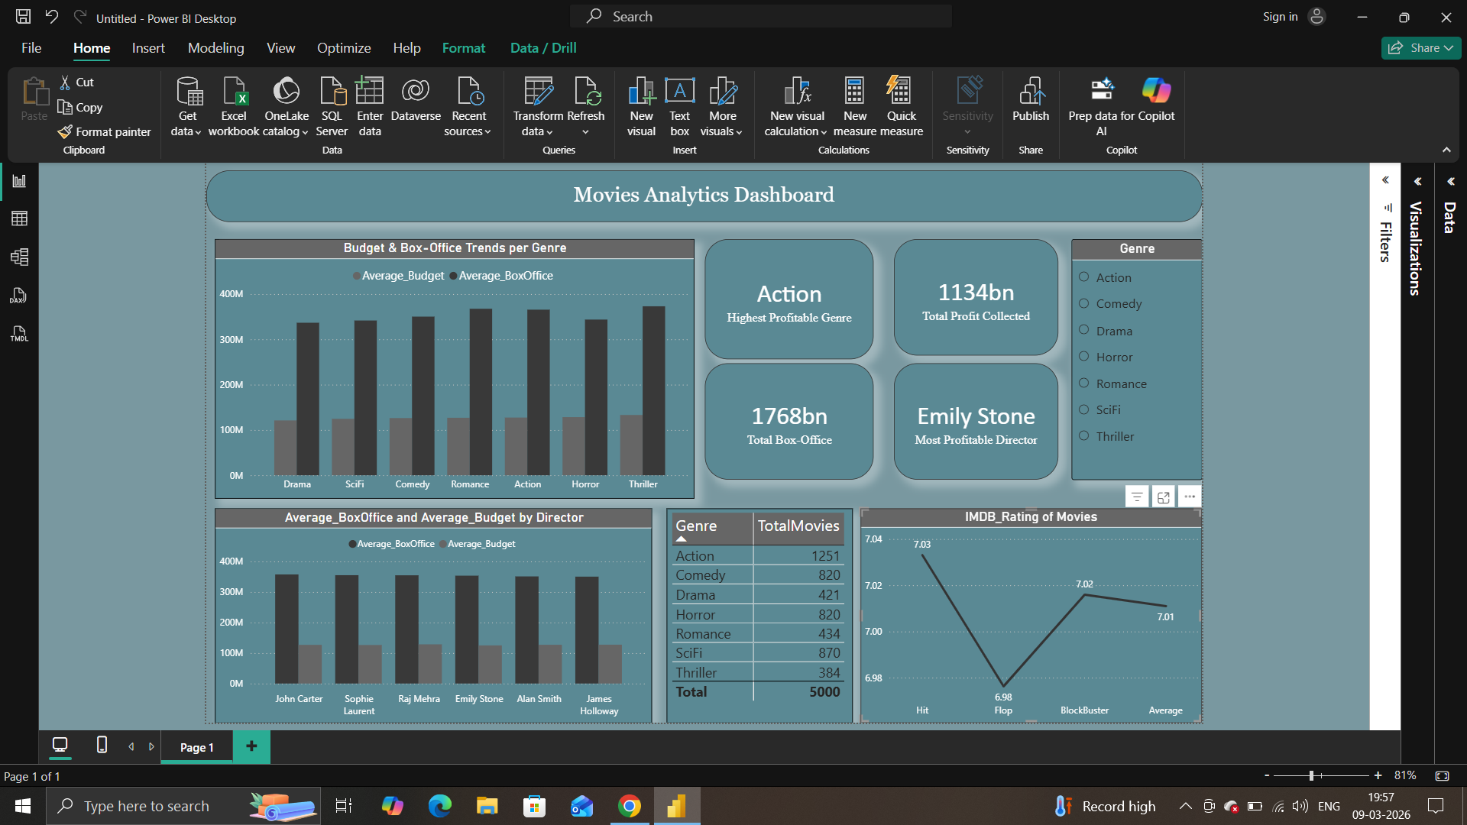
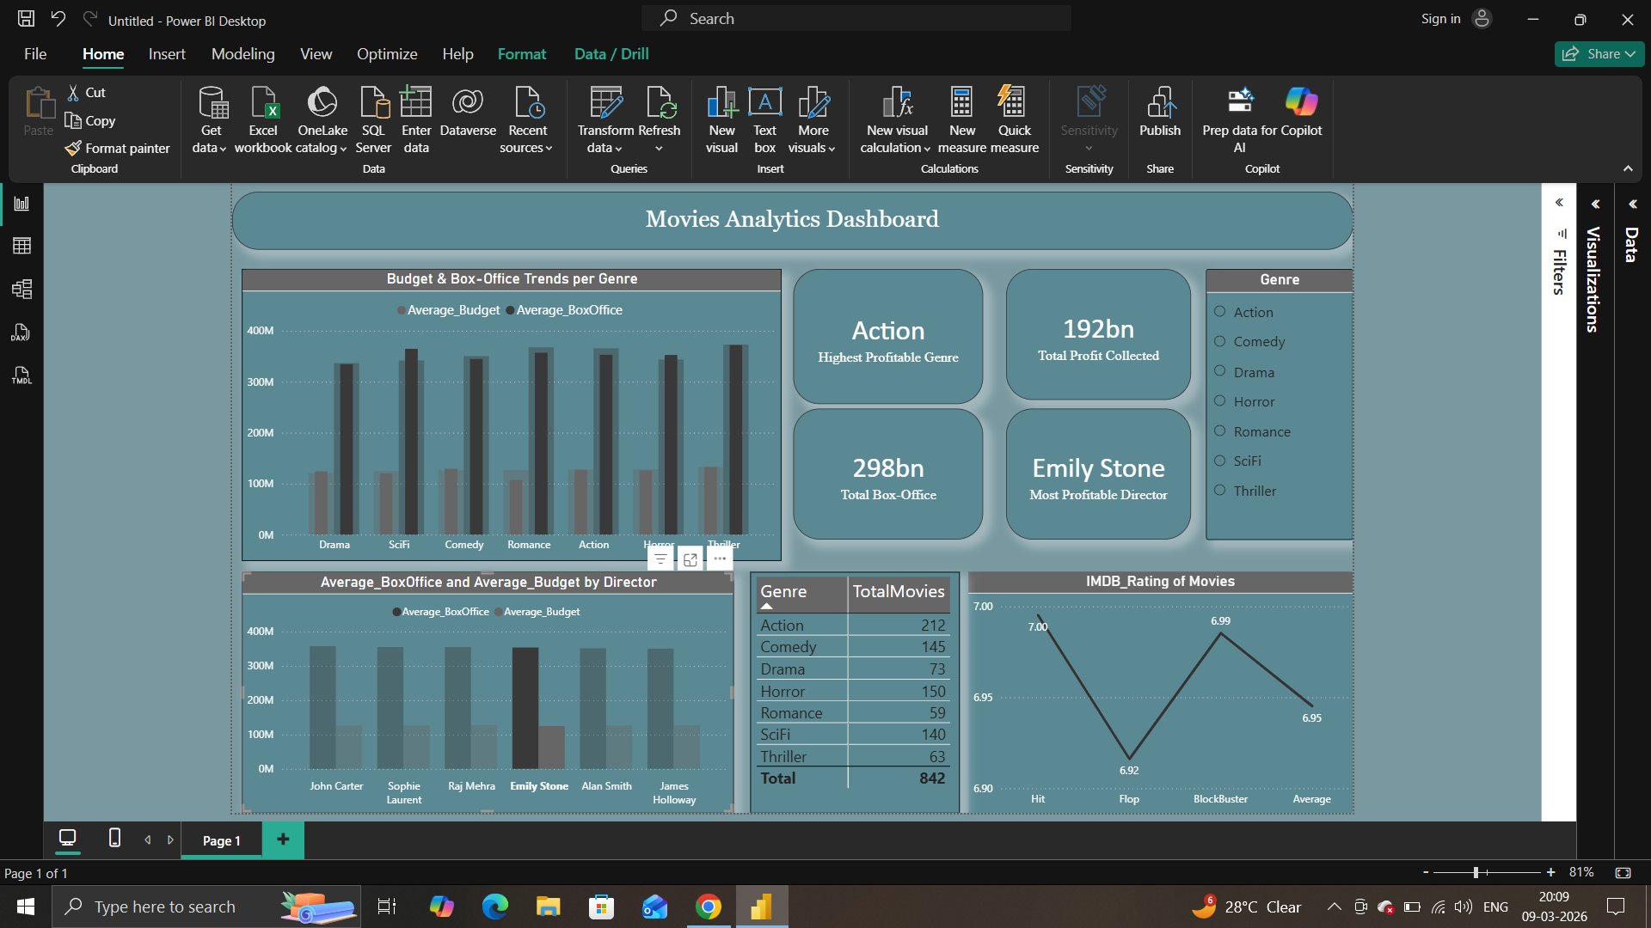
Insights : Director Term
Emily Stone ranks as the most profitable director, generating the highest total profit over period of time.
She has directed 842 movies, primarily in the Action genre, which also shows the highest average profitability among all genres.

Slide 10

Recommendations:
Studios may consider collaborating more with John Carter, as his consistent output and strong revenue performance indicate high commercial potential.
Allocate strategic budgets to high-performing genres and experienced directors to improve ROI.

Slide 11
Thank You

